Slide 2
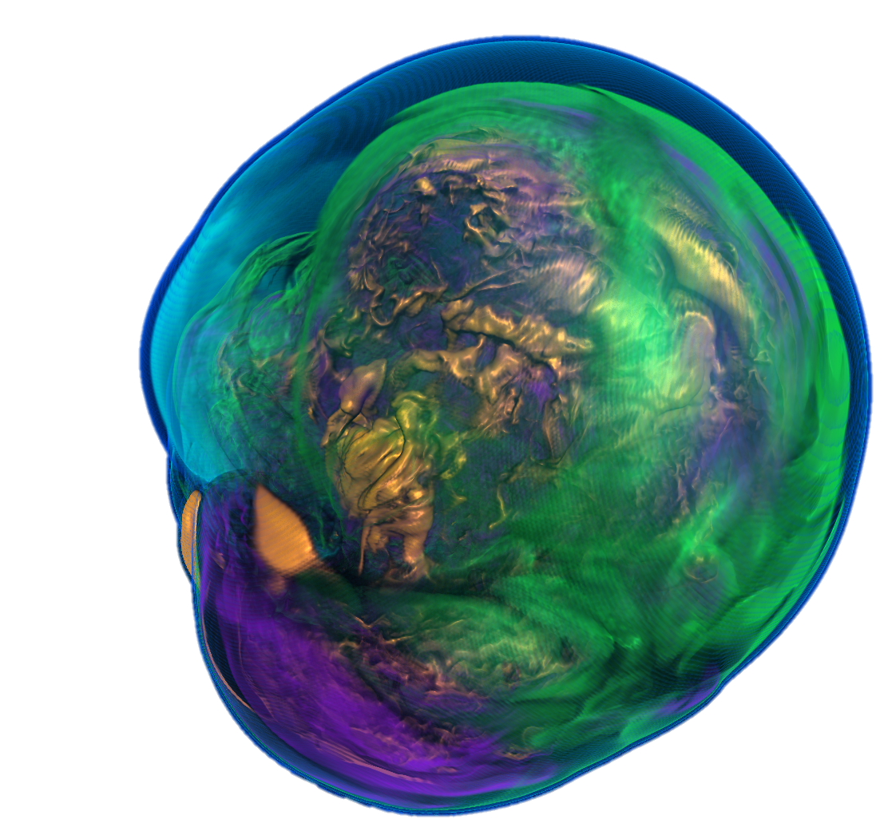
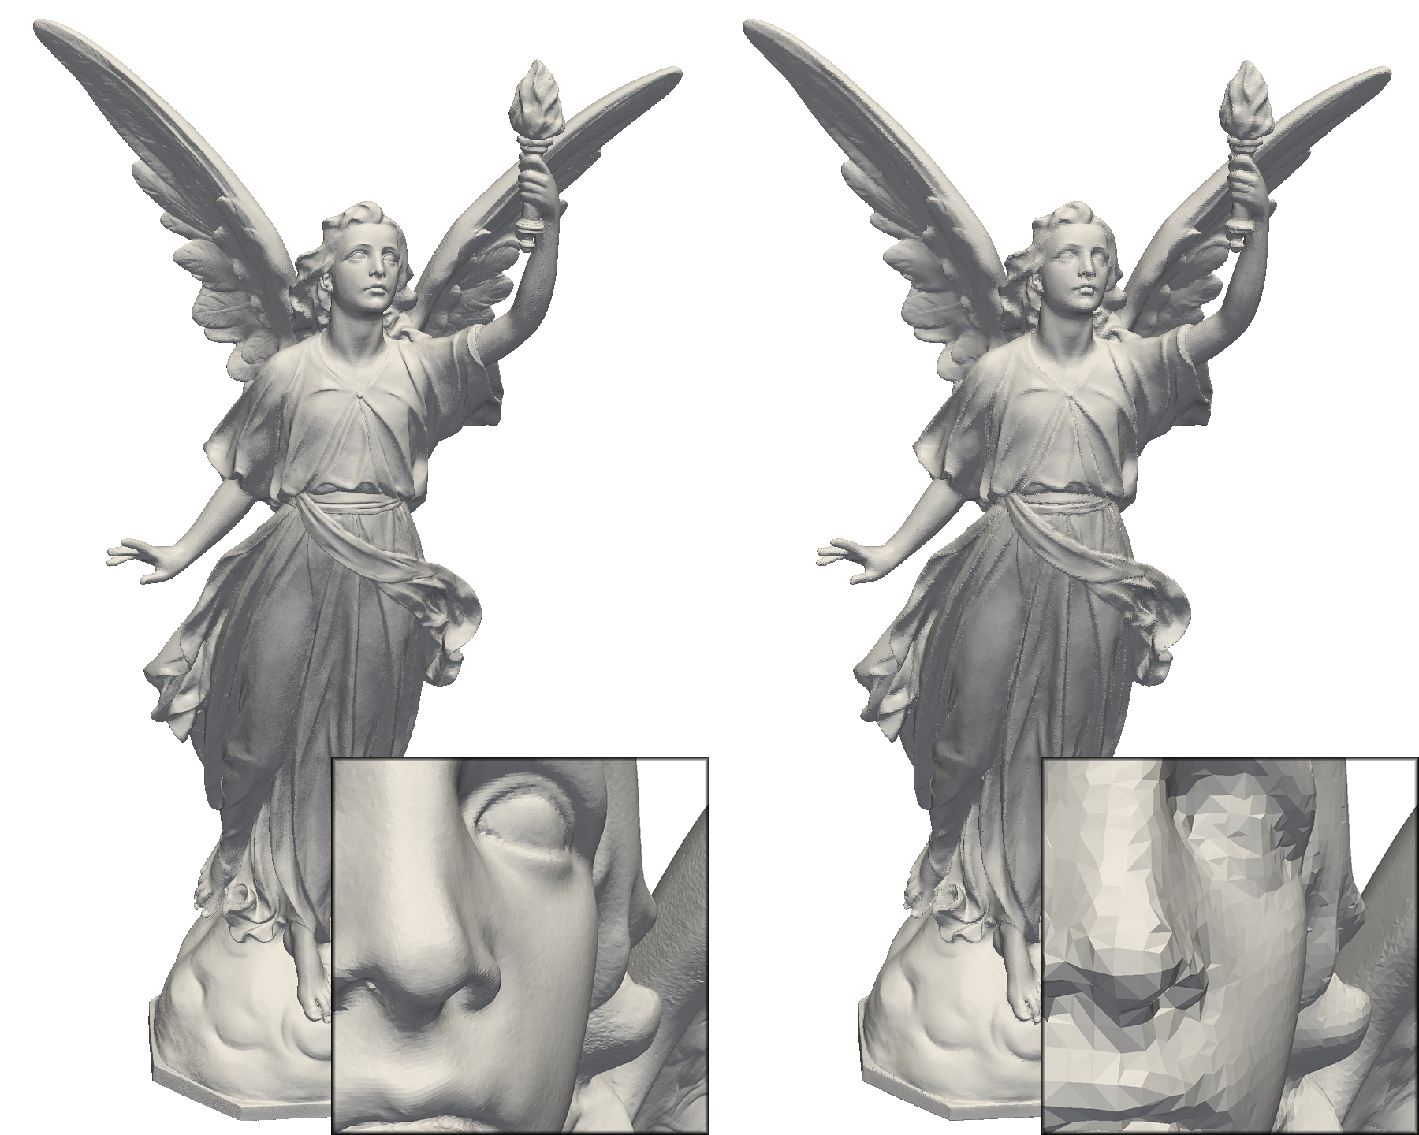
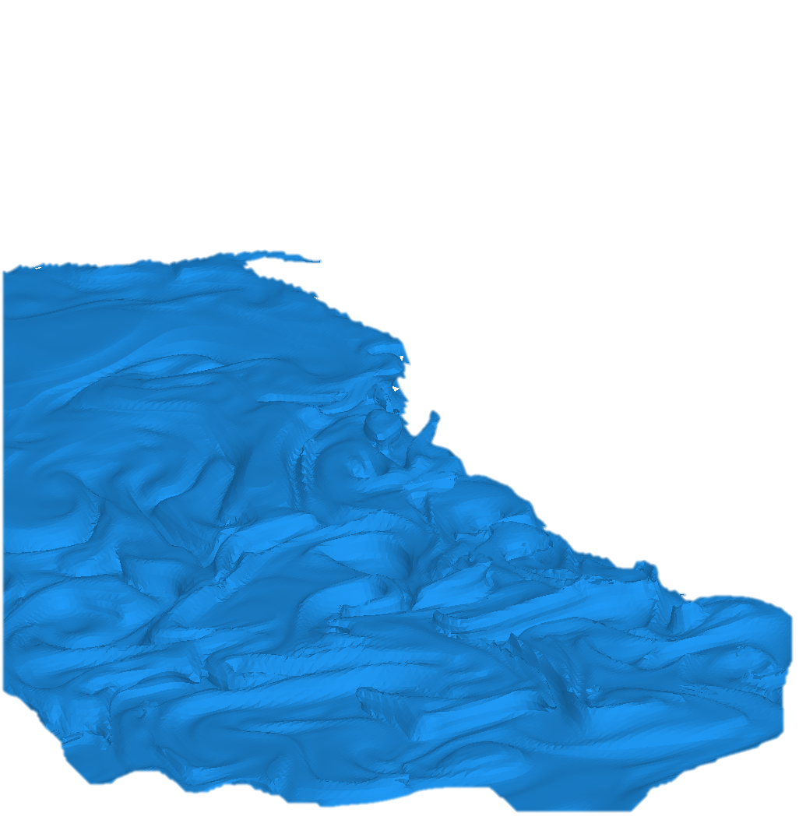
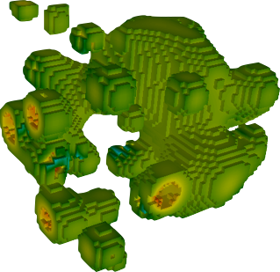
A single place for the visualization community to collaborate, contribute, and leverage massively threaded algorithms.
Reduce the challenges of writing highly concurrent algorithms by using data parallel algorithms
Make it easier for simulation codes to take advantage of these parallel visualization and analysis tasks on a wide range of current and next-generation hardware.
Notes:
The data parallel primitives allow us to write algorithm only once, but have them run on any number of hardware architectures.
Left to right images:
Rendered image of the supernova simulation using the VTK-m ray caster.
IsoSurface Generated by VTK-m
Threshold Generated by VTK-m
IsoSurface Generated by VTK-m

Slide 3
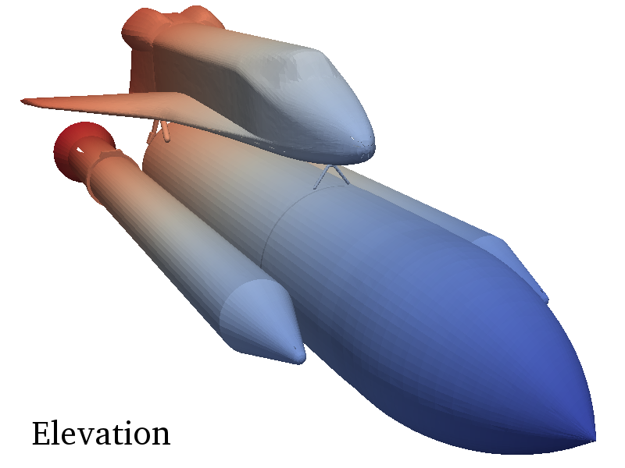
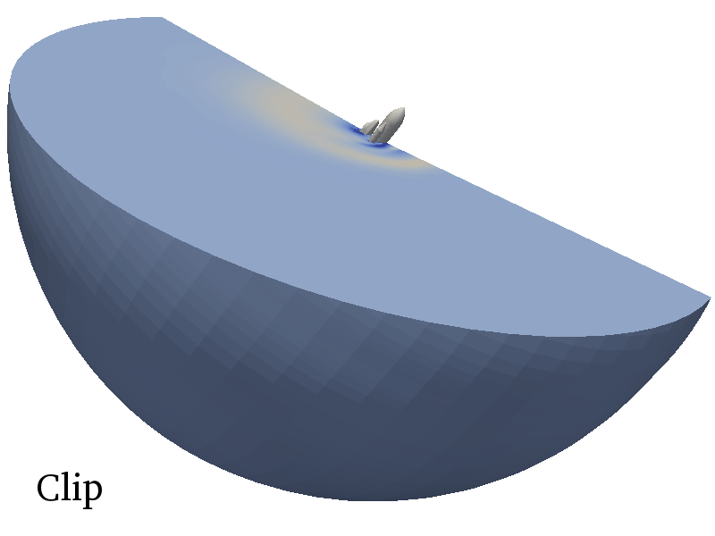
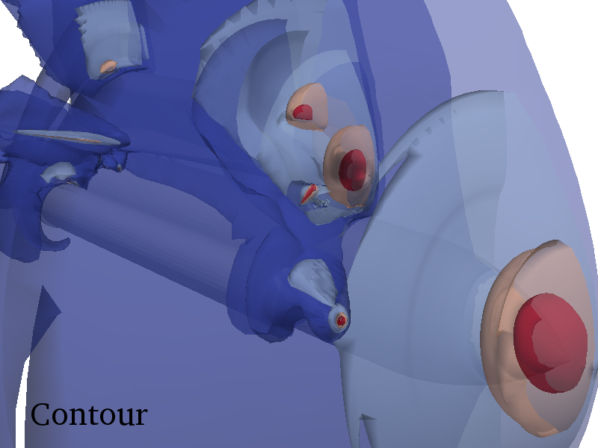
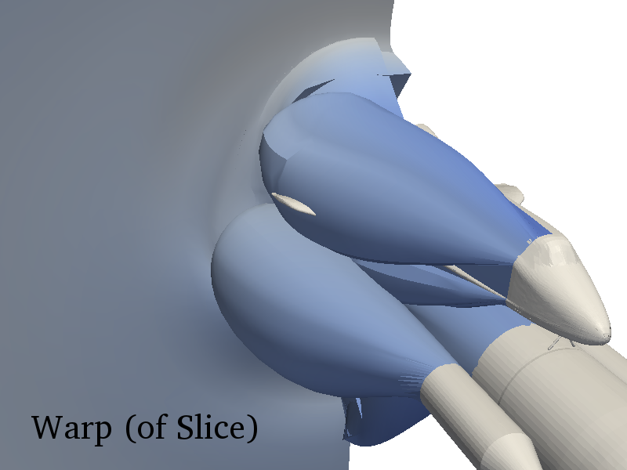
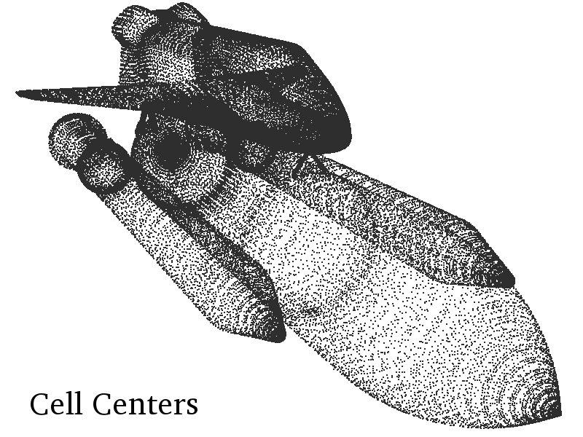
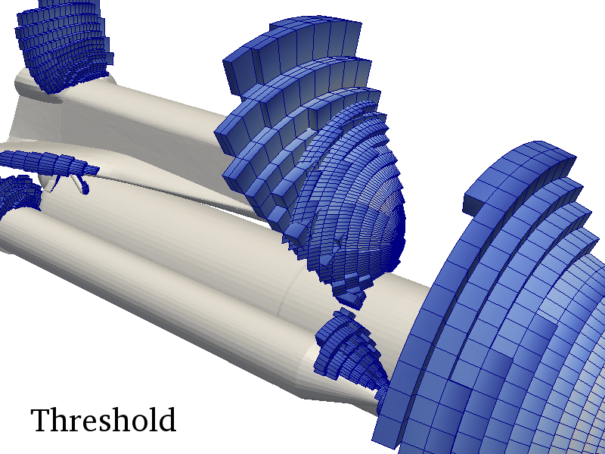
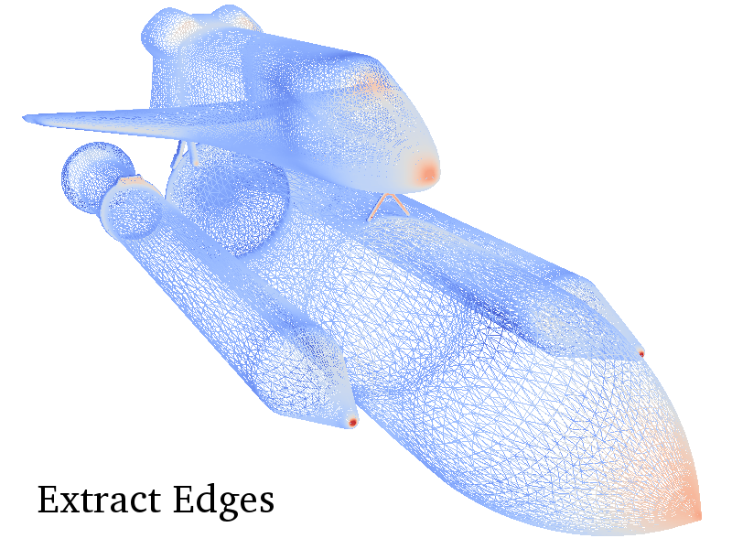
Device
CPU
GPU
MIC
???
VTK-m
Algorithm

Slide 4
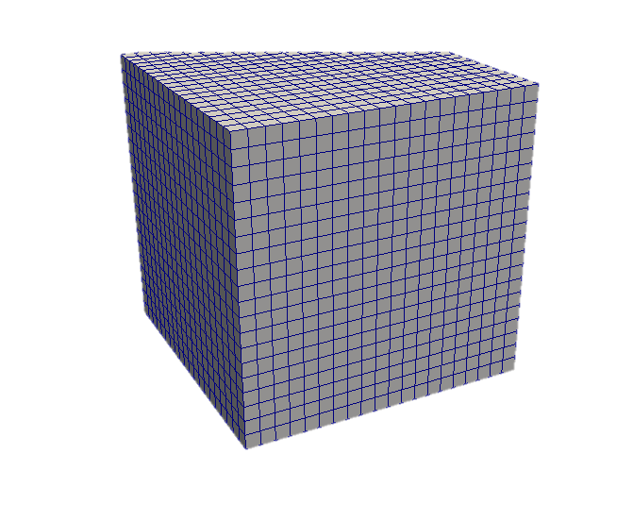
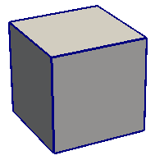
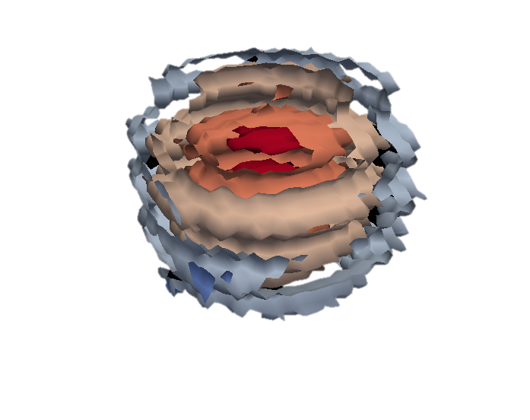
VTK-m Architecture
Control
Execution
Filters
Worklets
Control DataModel
Execution DataModel
Data Parallel Algorithms
Arrays
Notes:
These two environments, particularly the execution environment, are meant to work on a variety of architectures.
To manage this portability, we have a unit called a device adapter that sits between these two environments.
The device adapter provides the basic memory management, scheduling, and algorithms needed to run on a parallel device.

Slide 5
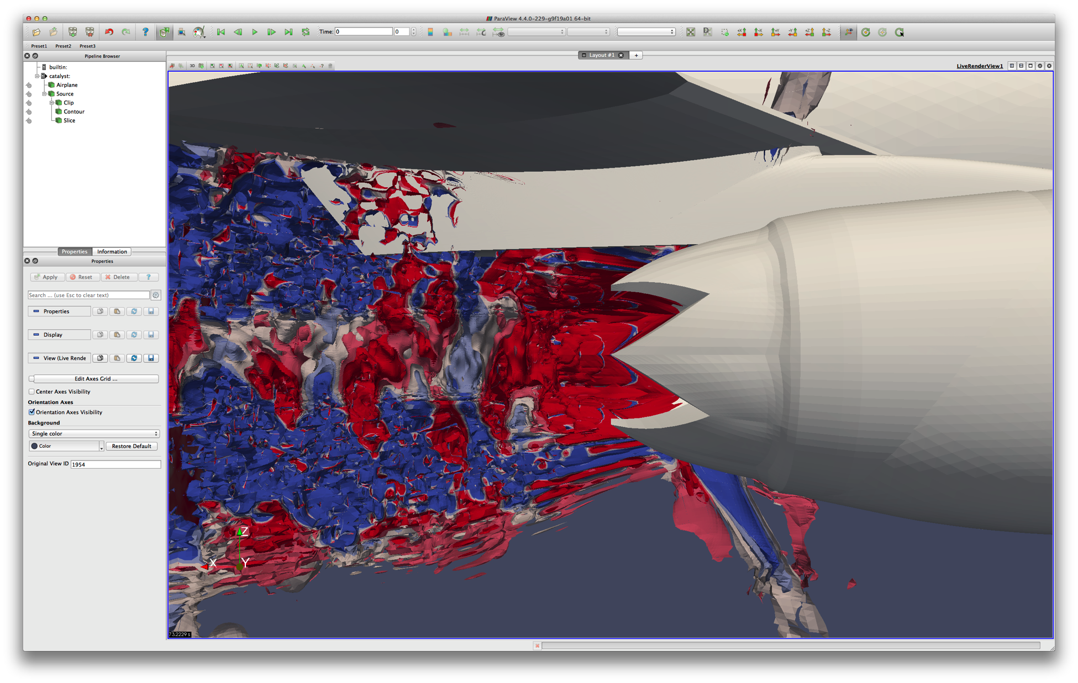


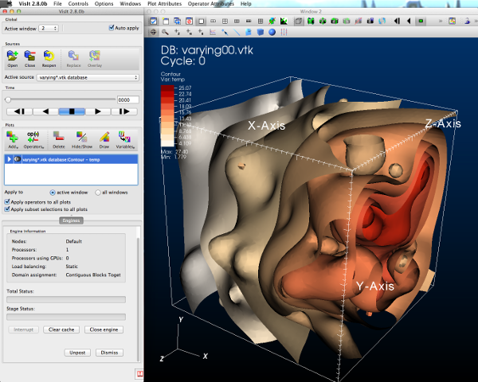

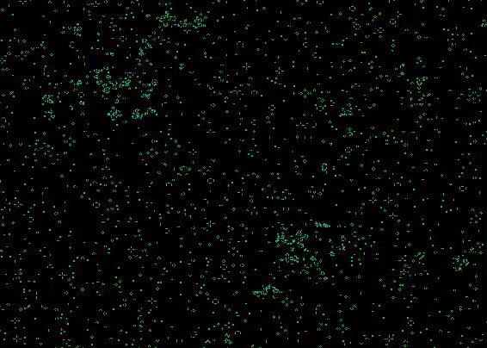


Reader
Filter
Filter
Simulation
Filter
Rendering

Slide 6
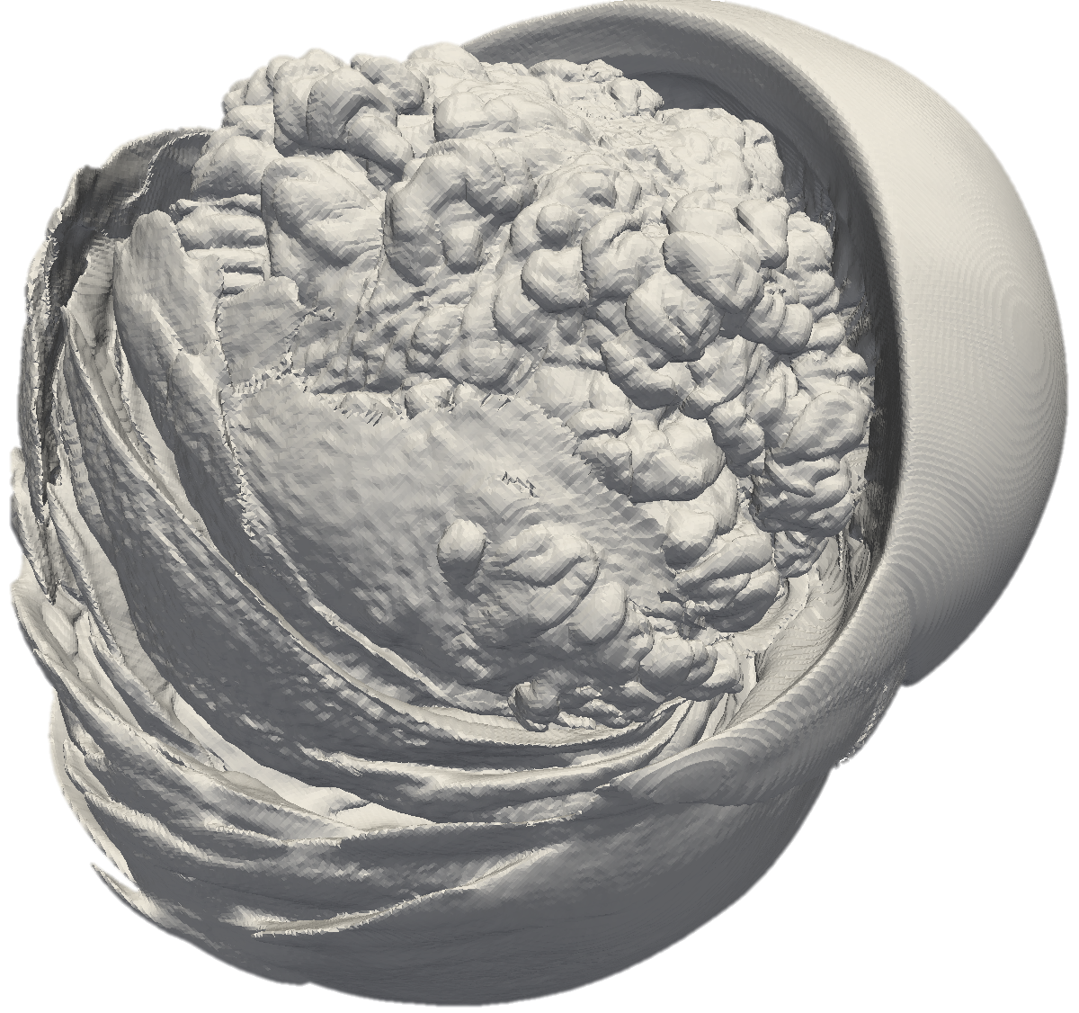
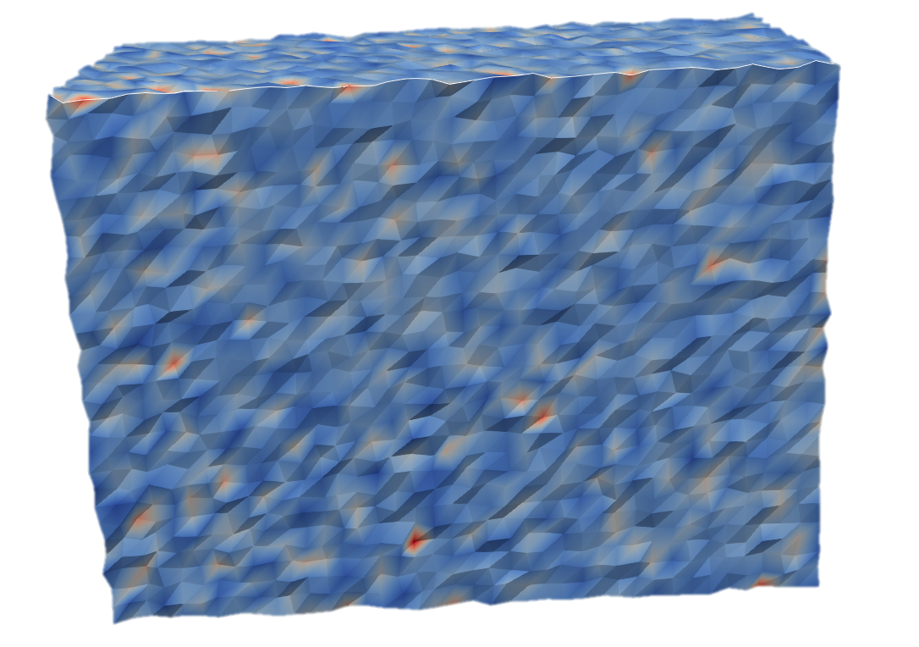
VTK-m Filters
Cell Average
Clean Grid
Clip by Field or Implicit Function
External Faces
Extract Geometry, Points, Structured
Gradient
Divergence, Vorticity, and Qcriterion
Fast paths for ‘StructuredGrids’, and ‘ImageData’
Histogram
Marching Cubes
Hex and Voxel only
Notes:
This isn’t an exhaustive list as some filters aren’t fully complete yet things like KDTree, Splats, Streamlines, Advection, Wavlet Compression have been started but not exposed as they are still more ‘research’

Slide 7
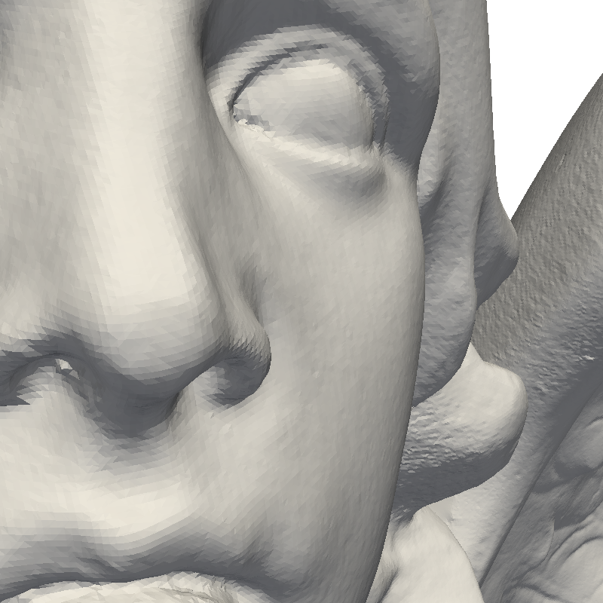
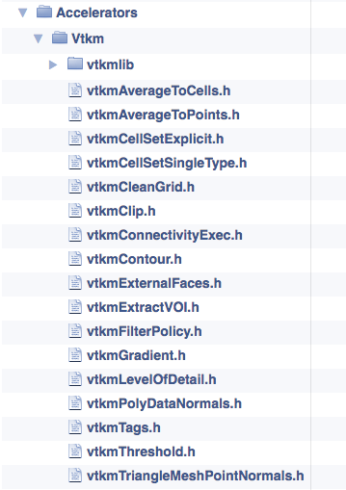
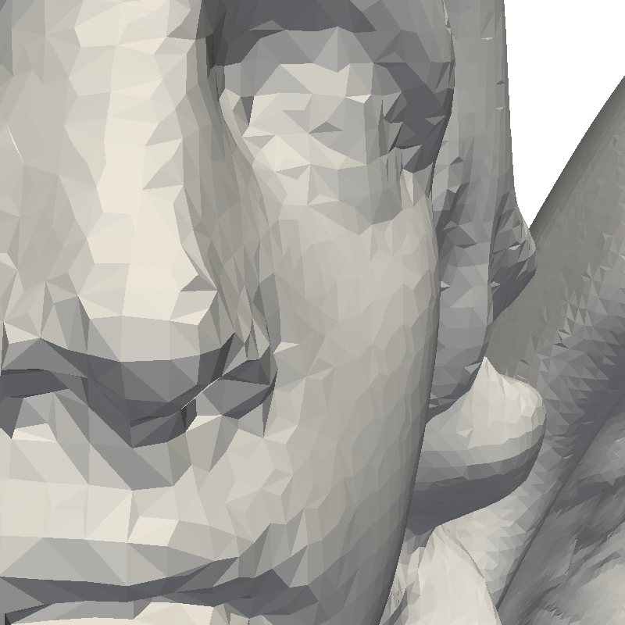
VTK-m Filters
Mask Points
Point Average
Point Elevation
Surface Normals
Faceted
Smooth
Tetrahedralize
Threshold
Triangulate
Vertex Clustering
Surface Simplification

Slide 8
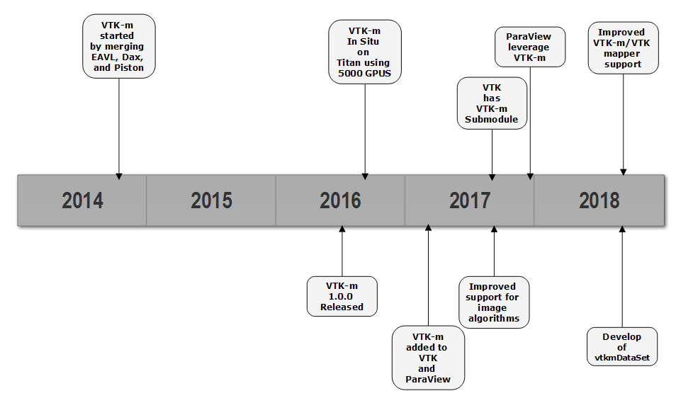
Reader
Filter
Filter
Rendering

Slide 9
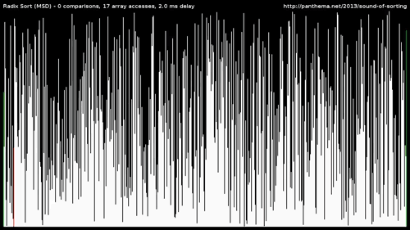
VTK-m Execution Performance
Portability must come with good performance to be advantageous
VTK-m looks at performance from two perspectives
Algorithmic performance
Data parallel primitive performance
Notes:
Going to talk about 2 different filters and the improvements we made to VTK-m for them

Slide 10
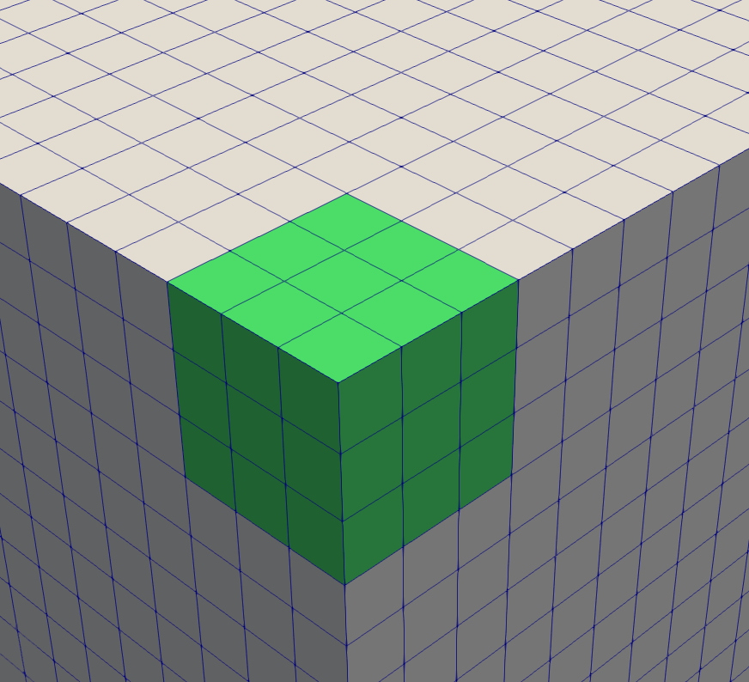
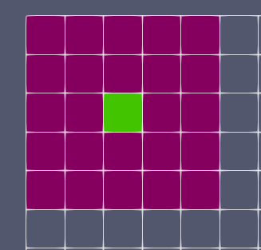
Gradient Performance
To improve the performance of gradients on uniform grids VTK-m has added the point neighborhood worklet type
Allows for execution on a per point location with neighborhood
2x Intel(R) Xeon(R) CPU E5-2620 v3

Slide 11

Level of Detail Performance
Level Of Detail is an algorithm that ParaView uses to facilitate interactivity with high triangle count models
Notes:
This isn’t an exhaustive list as some filters aren’t fully complete yet things like KDTree, Splats, Streamlines, Advection, Wavlet Compression have been started but not exposed as they are still more ‘research’

Slide 12
Level of Detail Performance
VTK-m is being used to develop a Level of Detail filter that will support higher resolution data
For this to occur we had to make sure the VTK-m parallel primitives scaled well
For Level of Detail this meant improving the performance of:
Copy and CopyIf
Reduce and ReduceByKey
Unique and UniqueByKey
2x Intel(R) Xeon(R) CPU E5-2620 v3

Slide 13
Level of Detail Performance
2x Intel(R) Xeon(R) CPU E5-2620 v3

Slide 14
Level of Detail Performance
2x Intel(R) Xeon(R) CPU E5-2620 v3

Slide 15
Level of Detail Performance
2x Intel(R) Xeon(R) CPU E5-2620 v3

Slide 16
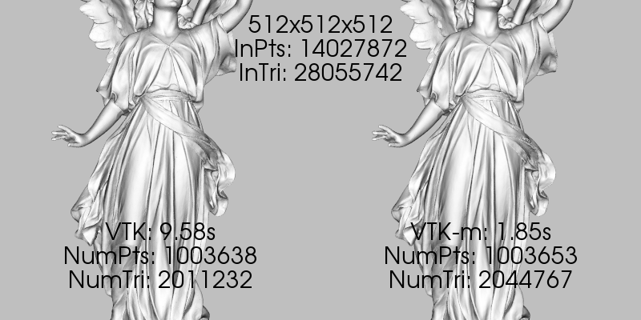
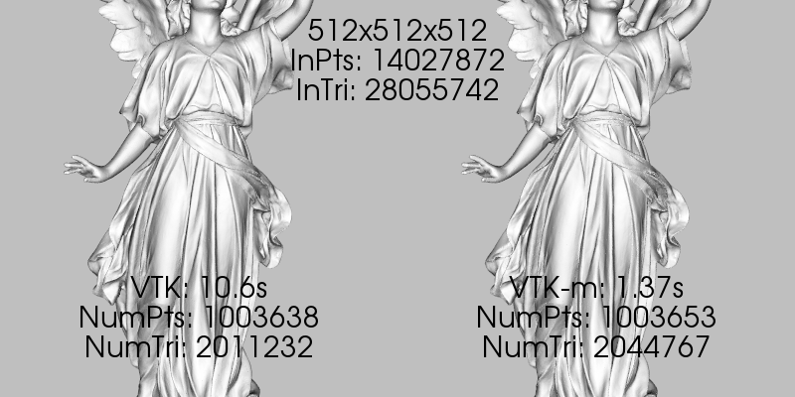
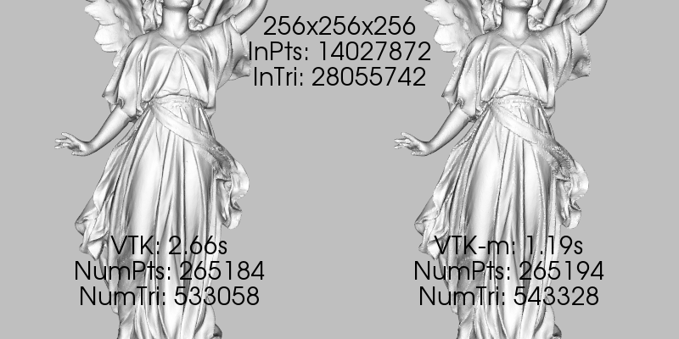
Level of Detail Performance
2x Intel(R) Xeon(R) CPU E5-2620 v3

Slide 17
On Going Work
Implementing a TBB radix sort for int/float/long/double data types for better performance and scaling
Redesign of TBB worklet execution to promote compiler vectorization.
Automatic transformation of aos to soa
Automatic block reads and writes
Notes:
This isn’t an exhaustive list as some filters aren’t fully complete yet things like KDTree, Splats, Streamlines, Advection, Wavlet Compression have been started but not exposed as they are still more ‘research’

Slide 18
Acknowledgments
This research was supported by the Exascale Computing Project (http://www.exascaleproject.org), a joint project of the U.S. Department of Energy’s Office of Science and National Nuclear Security Administration, responsible for delivering a capable exascale ecosystem, including software, applications, and hardware technology, to support the nation’s exascale computing imperative.
Project Number: 17-SC-20-SC

